Slide 1
Progressive Activists
February 2025

Slide 2
Our unique lens - The British Seven Segments
Overview
The ‘British Seven’ segments were formulated in our ‘Britain’s Choice’ report, published in 2020
They are created entirely from questions around five areas of core beliefs, drawn from social psychology: group identity and tribalism, perceived threat, parenting style and authoritarianism, moral foundations, personal agency and responsibility
No demographic information (race, class, or gender) is used for the segmentation, though the segments created by this process often have demographic differences
Segmentation shows that values and beliefs are powerful in influencing how individuals form opinions about issues and their behaviour. Often, the segments are more predictive of beliefs than any other metric
Group identity and tribalism
Perceived threat
Parenting style and authoritarianism
Moral foundations
Personal agency and responsibility

Slide 3
Progressive Activists | Civic Pragmatists | Disengaged Battlers | Established Liberals | Loyal Nationals | Disengaged Traditionalists | Backbone Conservatives
…a group for whom politics is an important part of their identity and who seek to correct long-standing injustices
…a group that cares about others, at home or abroad. They wish for less conflict and more compromise.
… a group that are just getting by. They blame the system for its unfairness, but not other people.
…a group that has done well and means well towards others, but also sees a lot of good in the status quo.
…a patriotic group, who worry that our way of life is threatened and also feel our society has become more unfair.
… a group that values a well-ordered society takes pride in hard work. They want strong leadership that keeps people in line.
… a group who are proud of their country, optimistic about Britain’s future, and who keenly follow the news.

Slide 4
Who are Progressive Activists?

Slide 5
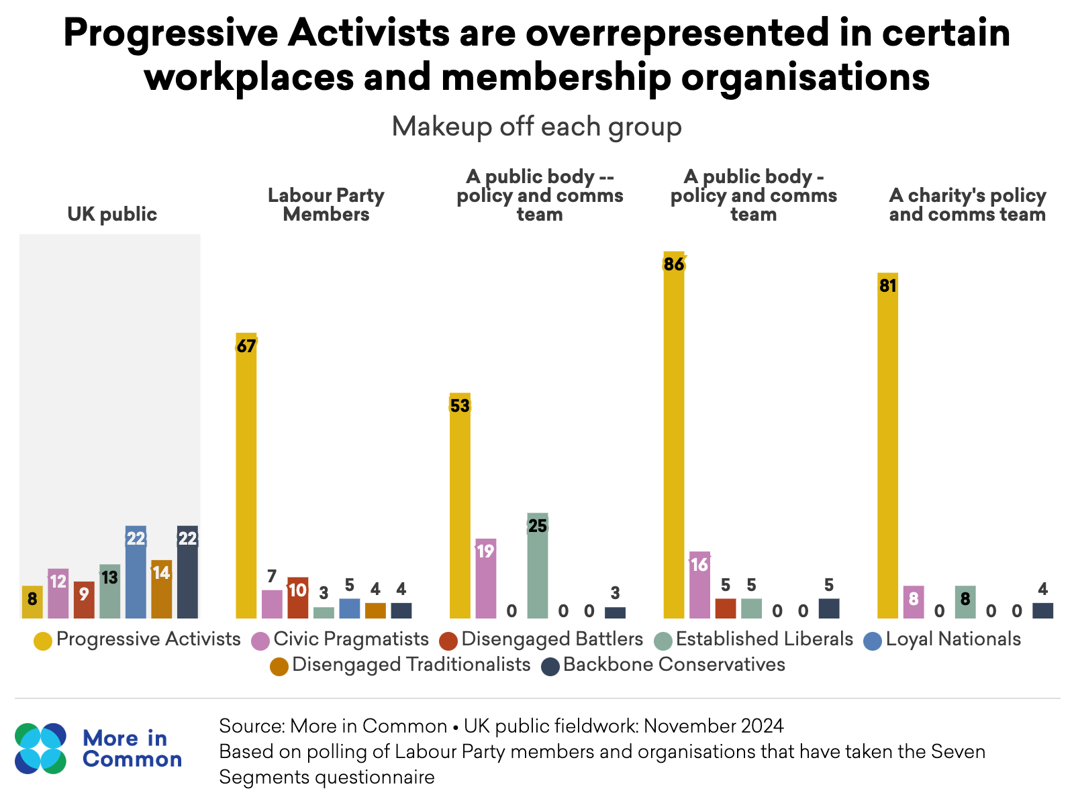
Why study Progressive Activists?
Progressive Activists make up around 10% of the UK population but have an outsized influence on public discourse due to their strong presence in activism, media, and politics. They play a vital role in driving social change but can also be outliers in their views, sometimes fueling ‘culture wars’ or misjudging mainstream public opinion. Their overrepresentation in policy, communications, and advocacy roles means they shape debates but may struggle to build broad-based coalitions for change. Recent setbacks in progressive causes highlight the need for greater awareness of how their views align—or diverge—from wider society to campaign more effectively.

Slide 6
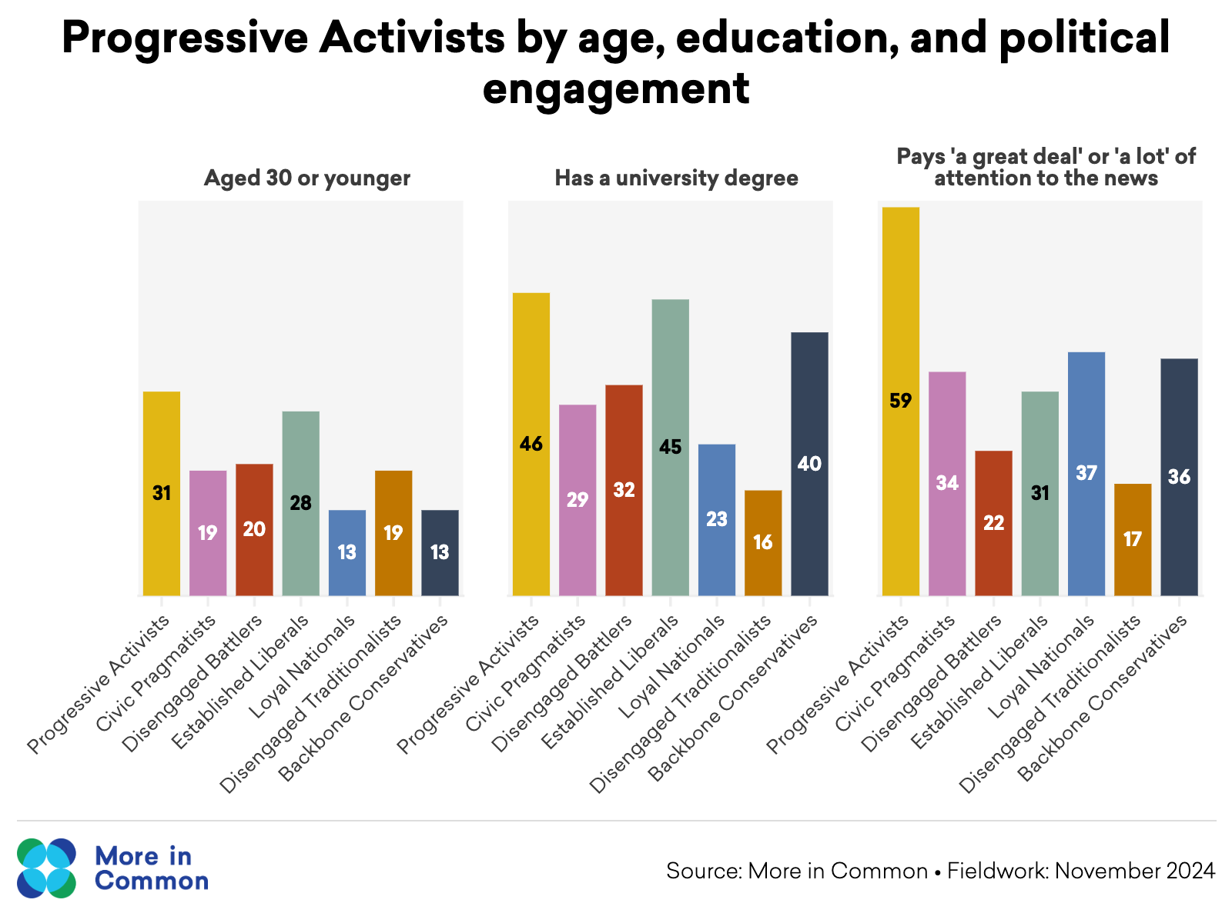
Who are Progressive Activists?
Progressive Activists are younger than average, more likely to be graduates and highly represented in charity and public sector organisations.
While they are not defined by their demographics, Progressive Activists are the youngest of Britain’s seven segments.
They are more likely to have spent time in higher education: 46 per cent have degrees and a fifth have postgraduate degrees. Their level of education means that many Progressive Activists have high incomes, but because very few of them own a home and many of them are in student debt, they are a lower wealth segment.

Slide 7
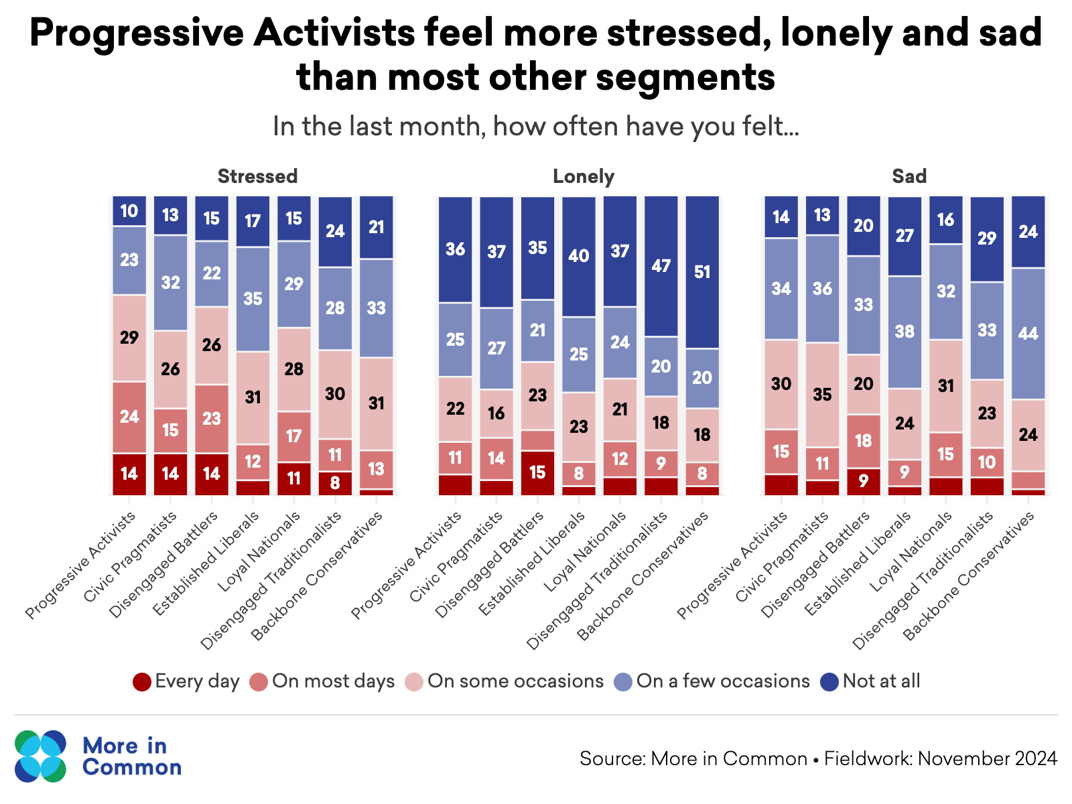
Progressive Activists have a pessimistic outlook on their future
Forty one per cent of Progressive Activists say their parents will have a more comfortable life than they will live; Progressive Activists express lower satisfaction with their housing, finances and work lives than average.
Fifty two per cent of Progressive Activists say they have suffered from mental health problems, and they are among the segments most likely to say they are often stressed, lonely and sad.

Slide 8
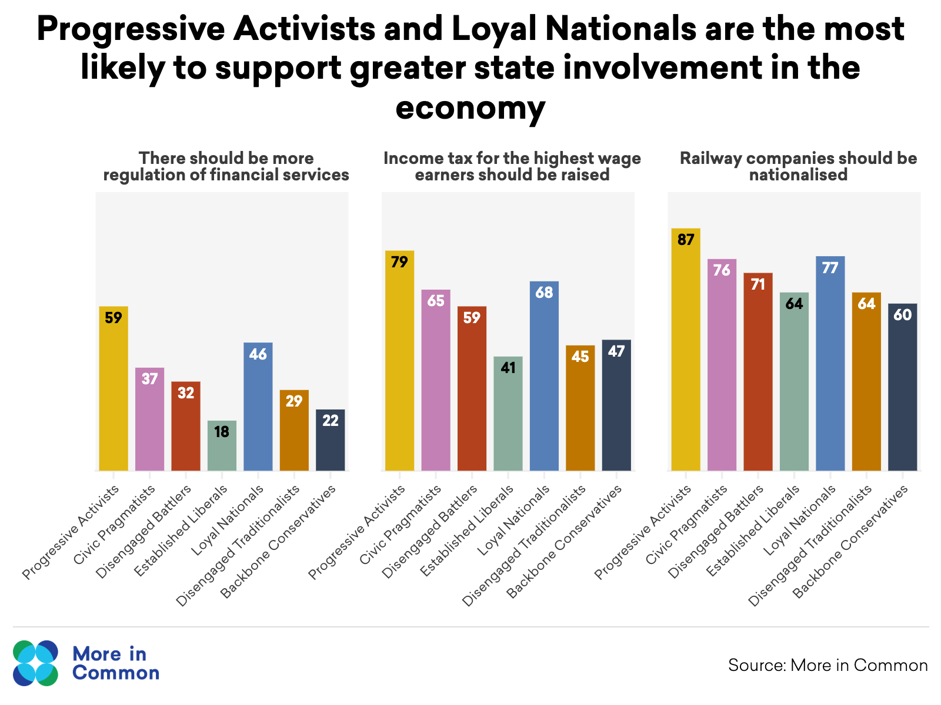
Progressive Activists on the economy
Progressive Activists are similar to left-leaning segments on the economy.
Their starting points on the role of business, the impact of capitalism and the scale of change needed in our economy is shared with other economically left-leaning groups such as Disengaged Battlers and ’Red Wall’ Loyal Nationals, who all favour a more interventionist state and are sceptical about big business.

Slide 9
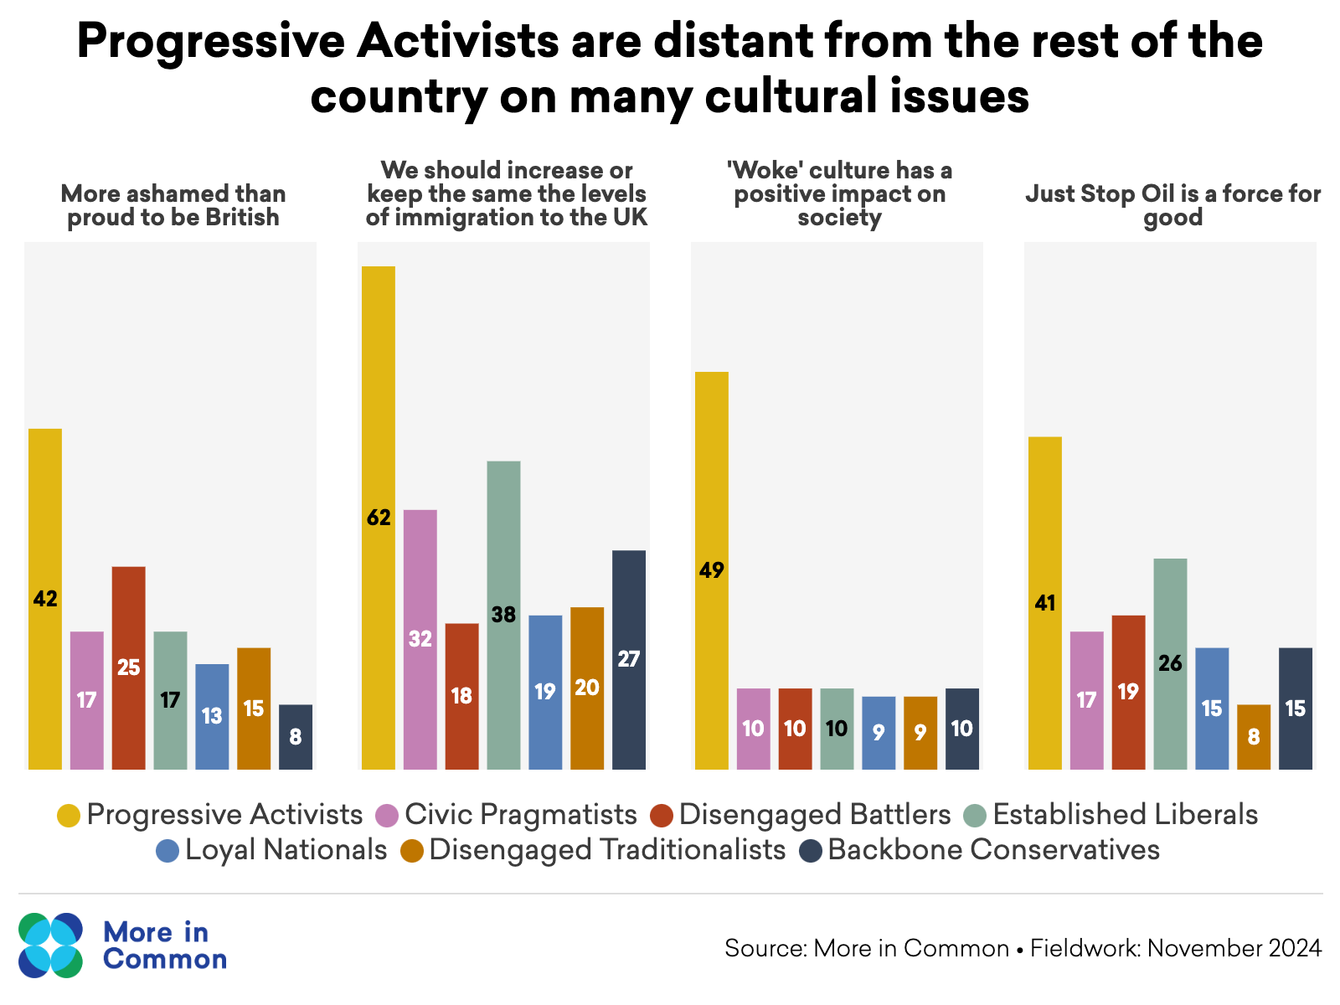
Progressive Activists on social / cultural issues
However, Progressive Activists diverge from the rest of Britain in their attitudes to many cultural and social issues. They are more than twice as likely than the rest of the country to say they are ashamed to be British and are the only segment to say that Britain should be ashamed of the legacy of the British Empire. Progressive Activists are also the only segment in which a majority say we should increase or maintain levels of immigration to the UK.

Slide 10
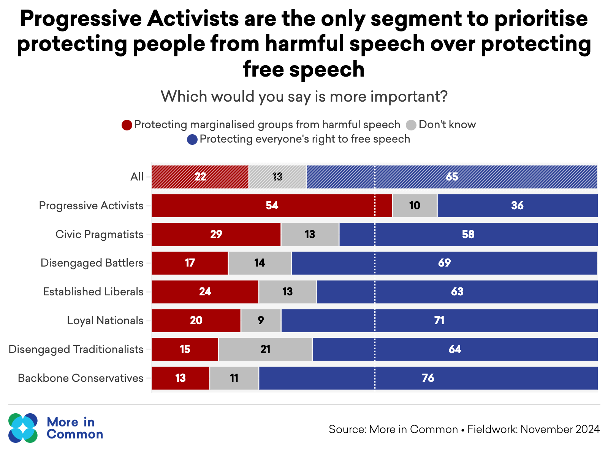
Progressive Activists are less willing to make space for debate
Progressive Activists are less willing than other groups to make space for debate on divisive issues. Progressive Activists are the only segment to say we should prioritise protecting people from hate speech over protecting freedom of speech, and are more likely than other groups to believe that some issues should not be subject to debate at all.

Slide 11
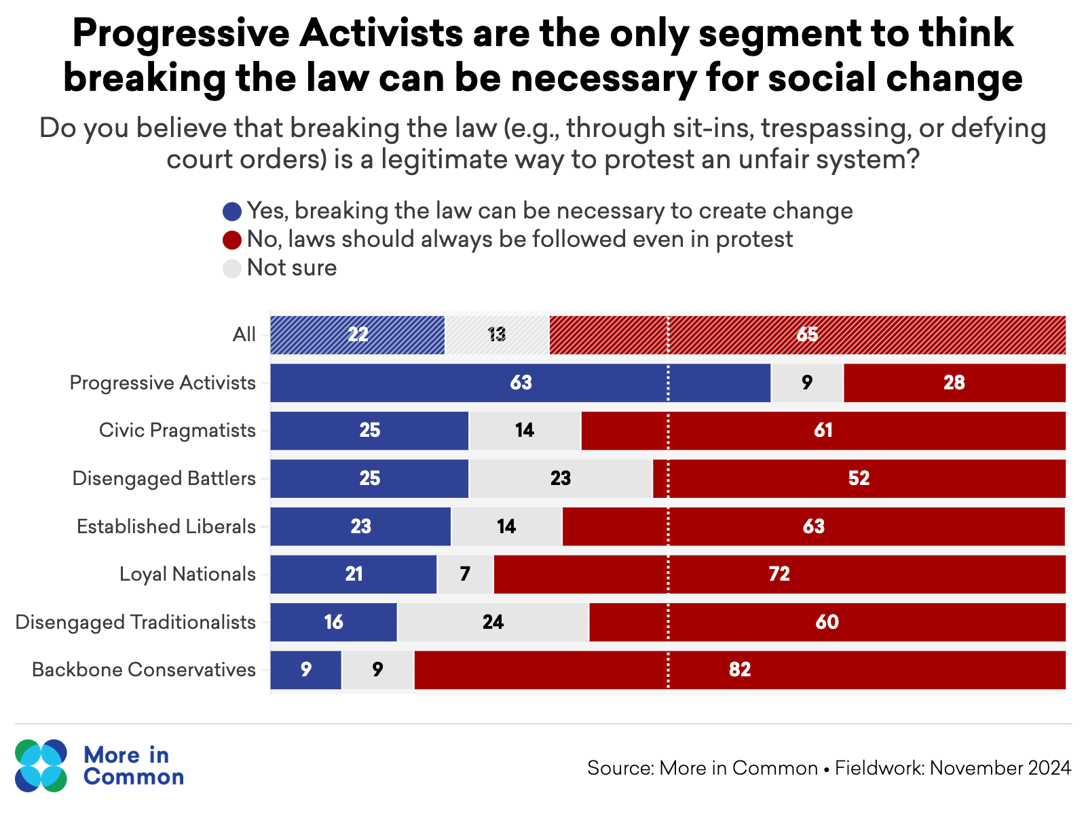
Progressive Activists on protest
Progressive Activists are much more supportive of disruptive forms of protest. For example, they are the only segment to see Just Stop Oil as a force for good. Sixty five per cent of the public believe that blocking roads is never an acceptable form of protest, compared to just 25 per cent of Progressive Activists.

Slide 12
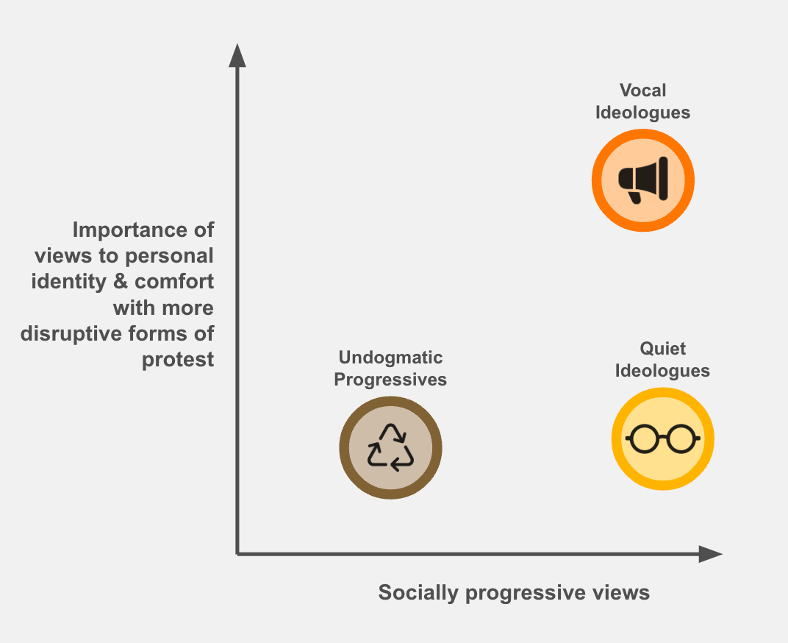
Three Progressive Activist archetypes
Undogmatic Progressives hold more moderate progressive views and see politics as less central to their identity. They are more open to compromise on certain issues, and less restrictive about who should or should not be involved in progressive campaigns.
Quiet Ideologues hold strong progressive beliefs and share the same fundamental worldview as Vocal Ideologues, but prefer not to express these views publicly or challenge authority directly. They are more likely to work within organisational structures and avoid workplace confrontation.
Vocal Ideologues are the most outspoken and of the three groups - they see their political beliefs as central to their identity and feel compelled to speak out against perceived injustice wherever they encounter it. They are more willing to challenge authority and support disruptive tactics.

Slide 13
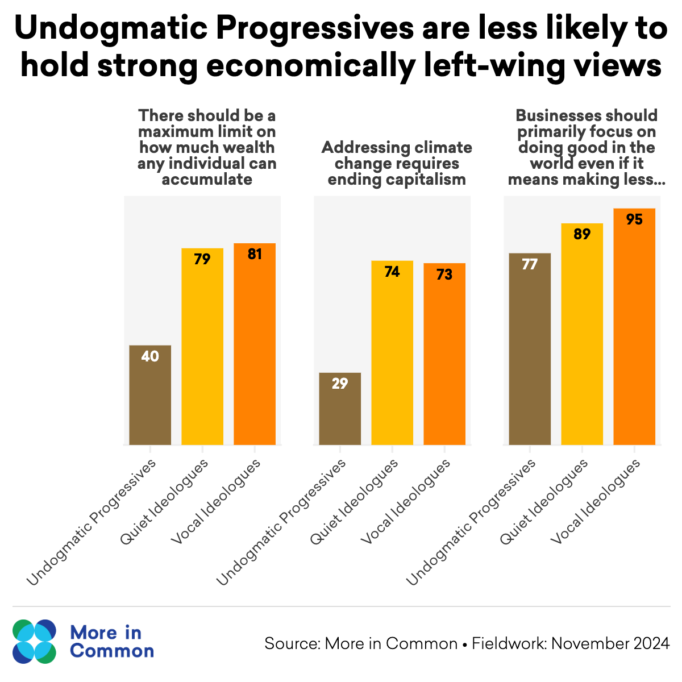
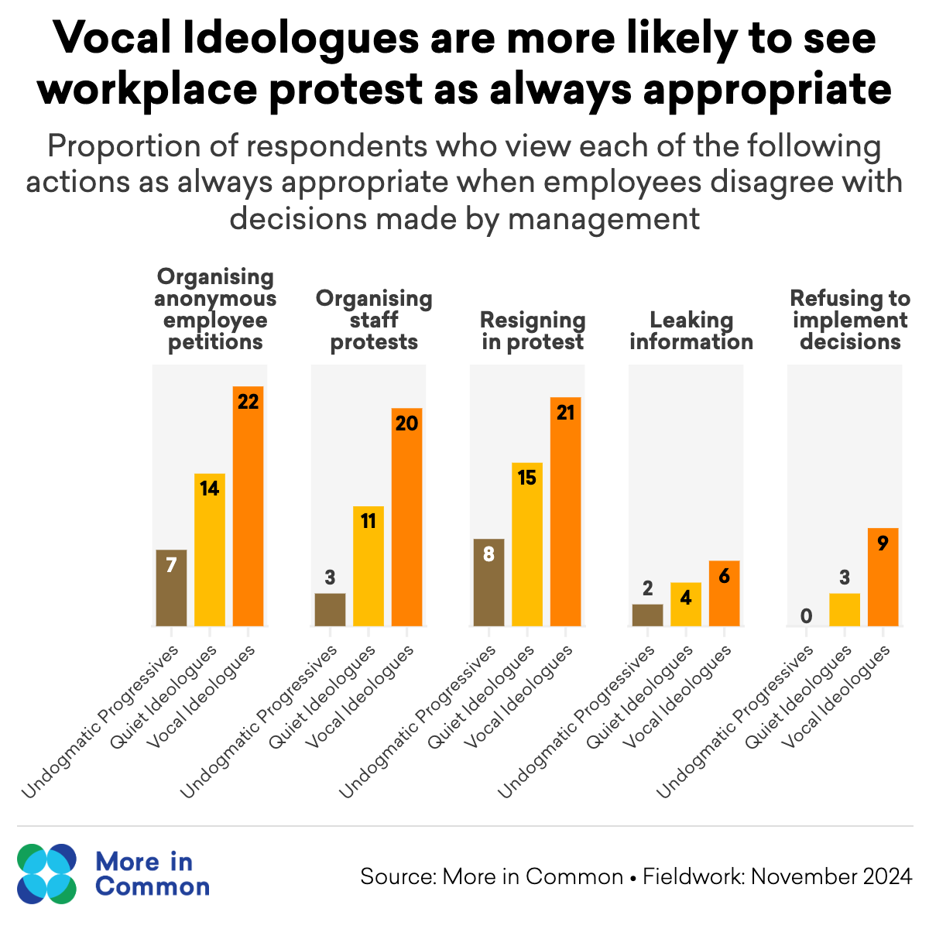
Three Progressive Activist archetypes

Slide 14
Inclusive and effective campaigning

Slide 15
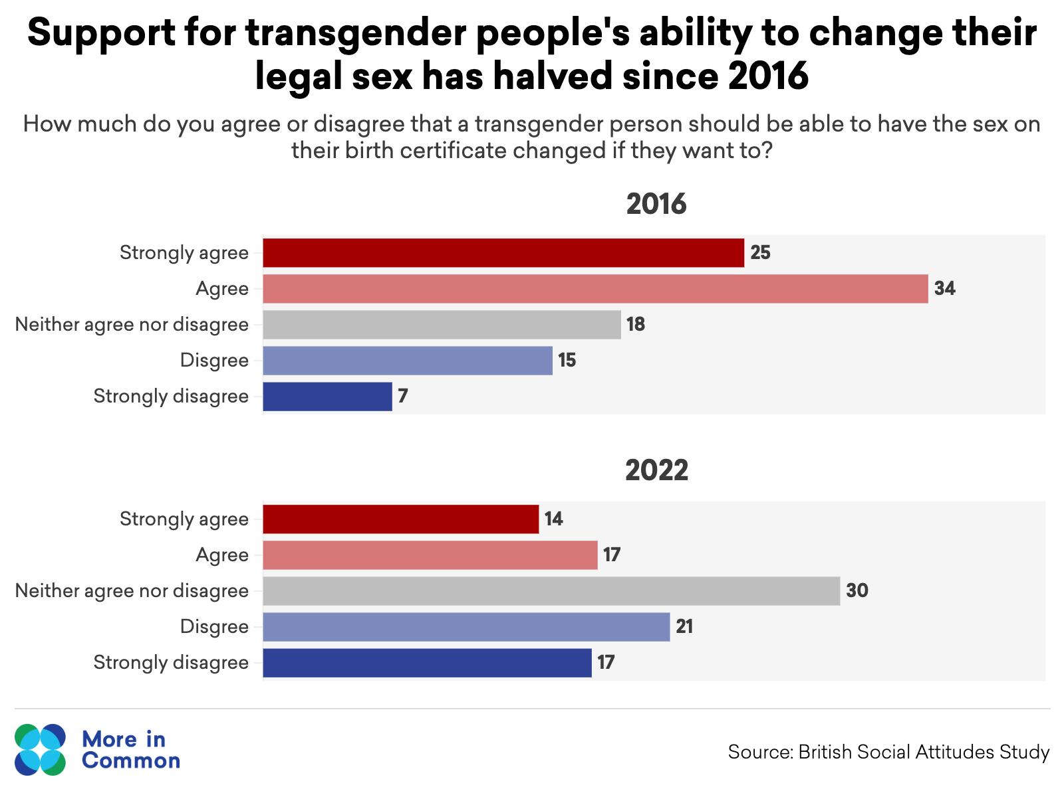
Is progressive campaigning working?
Donald Trump's victory in the 2024 election served as a wake-up call for progressive campaigners, with post-election research showing voters felt Democrats prioritized social issues over economic concerns. This pattern of progressive campaigns struggling to maintain public support isn't limited to the US. In the UK, support for transgender people's right to change their legal sex has dropped dramatically from 58% in 2016 to 30% in 2022, despite increased advocacy during this period.

Slide 16
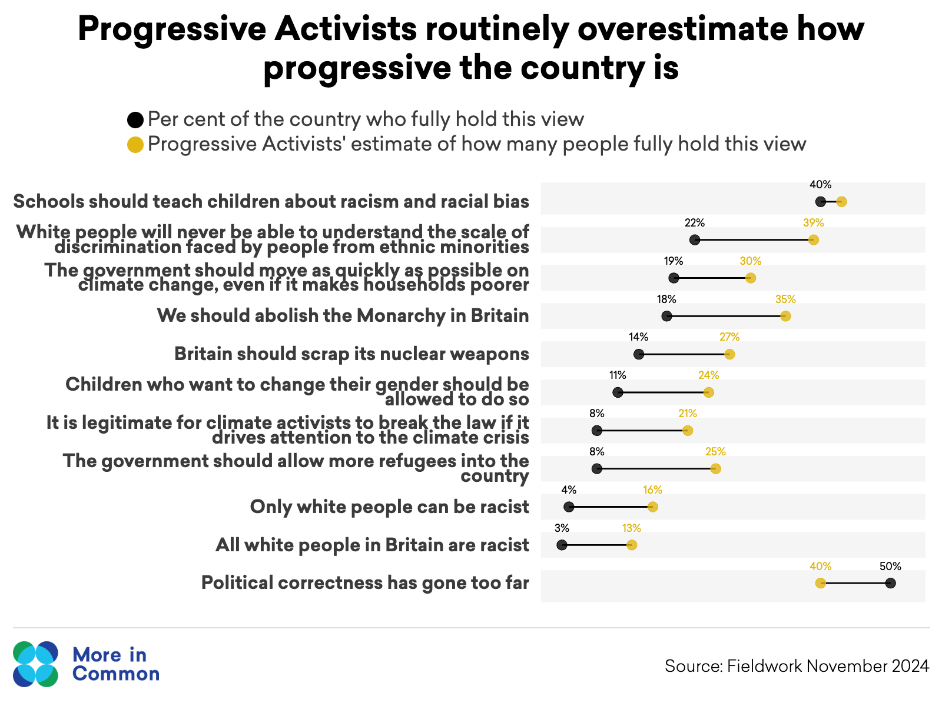
Know your audience
Progressive Activists tend to overestimate the extent of support for progressive causes in Britain by a factor of two or three. This can mean campaigners are less likely to see the need to expand their coalition. Campaigners who overestimate their starting support are more likely to focus on messages and tactics designed to ‘activate the base’ and which command ‘in-group approval’ rather than persuading those who are more agnostic and sceptical. For many campaigns, the starting point should be persuasion and listening.

Slide 17
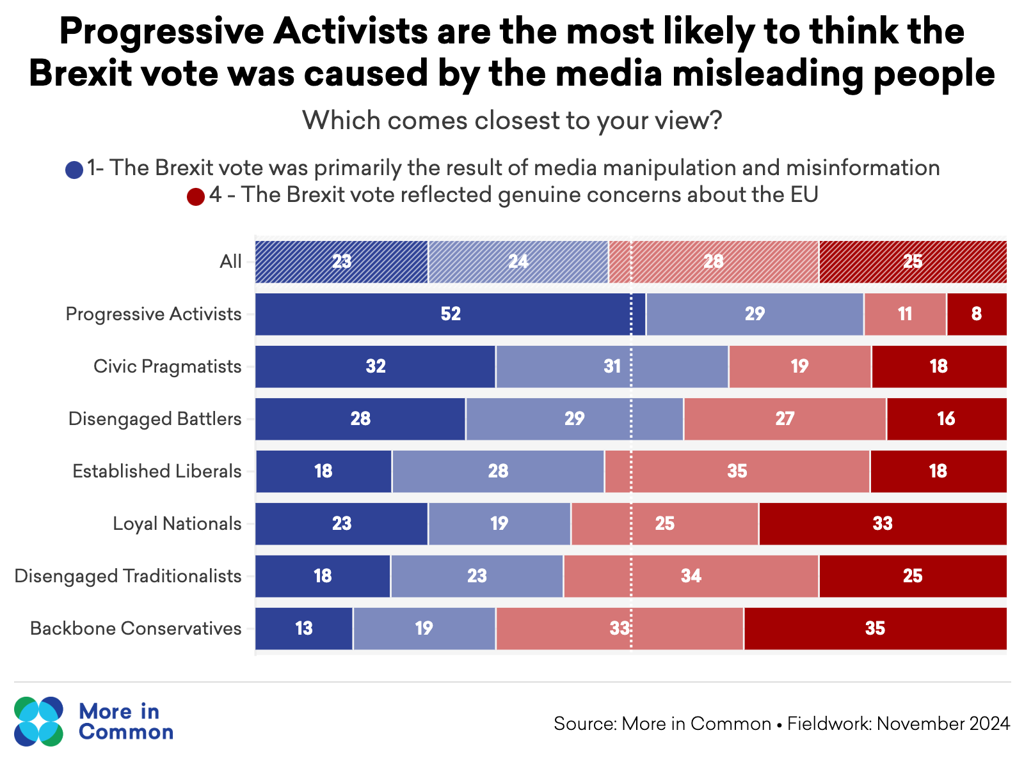
Don’t dismiss opposing views
Progressive Activists are much more likely to think that people with opposing views only hold those views as a result of misinformation or prejudice.
Brexit provides a good example of this tendency: Progressive Activists are significantly more likely to say the result of the referendum was a result of media manipulation and misinformation than to cite genuine concerns about the EU. This in turn leads to a perception among some Brexit voters that progressives are sneering at them for being hoodwinked and that they do not really understand their concerns.

Slide 18
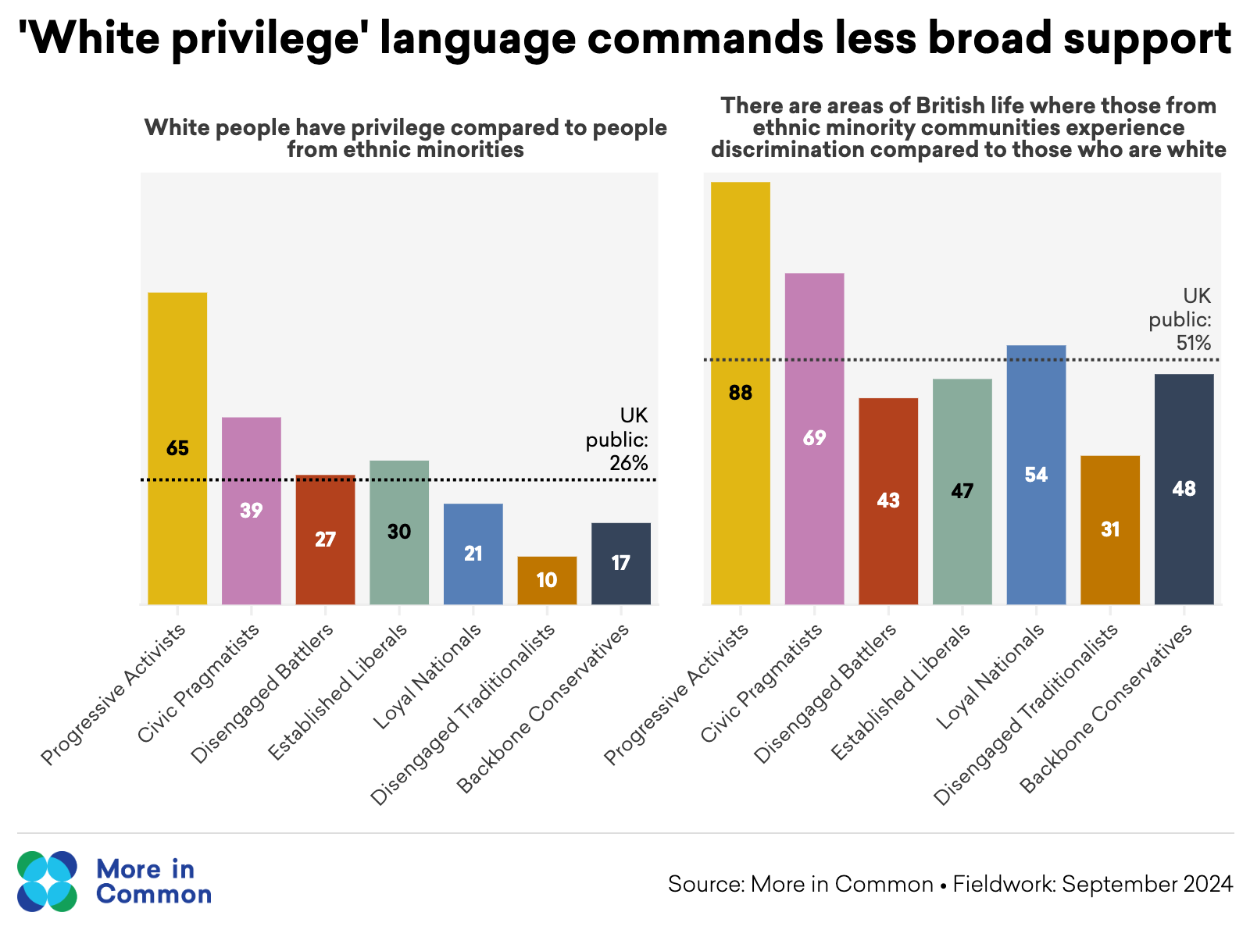
Use inclusive framing
Much of the language used by Progressive Activists is popular with other Progressive Activists and effective at mobilising their support, but falls flat with other segments. The persistence of racial discrimination is recognised across society, but the concept of white privilege is not. Using framings which reinforce ‘us versus them’ dynamics undermines support for progressive causes - even when the public generally ideas with those ideas in principle.

Slide 19
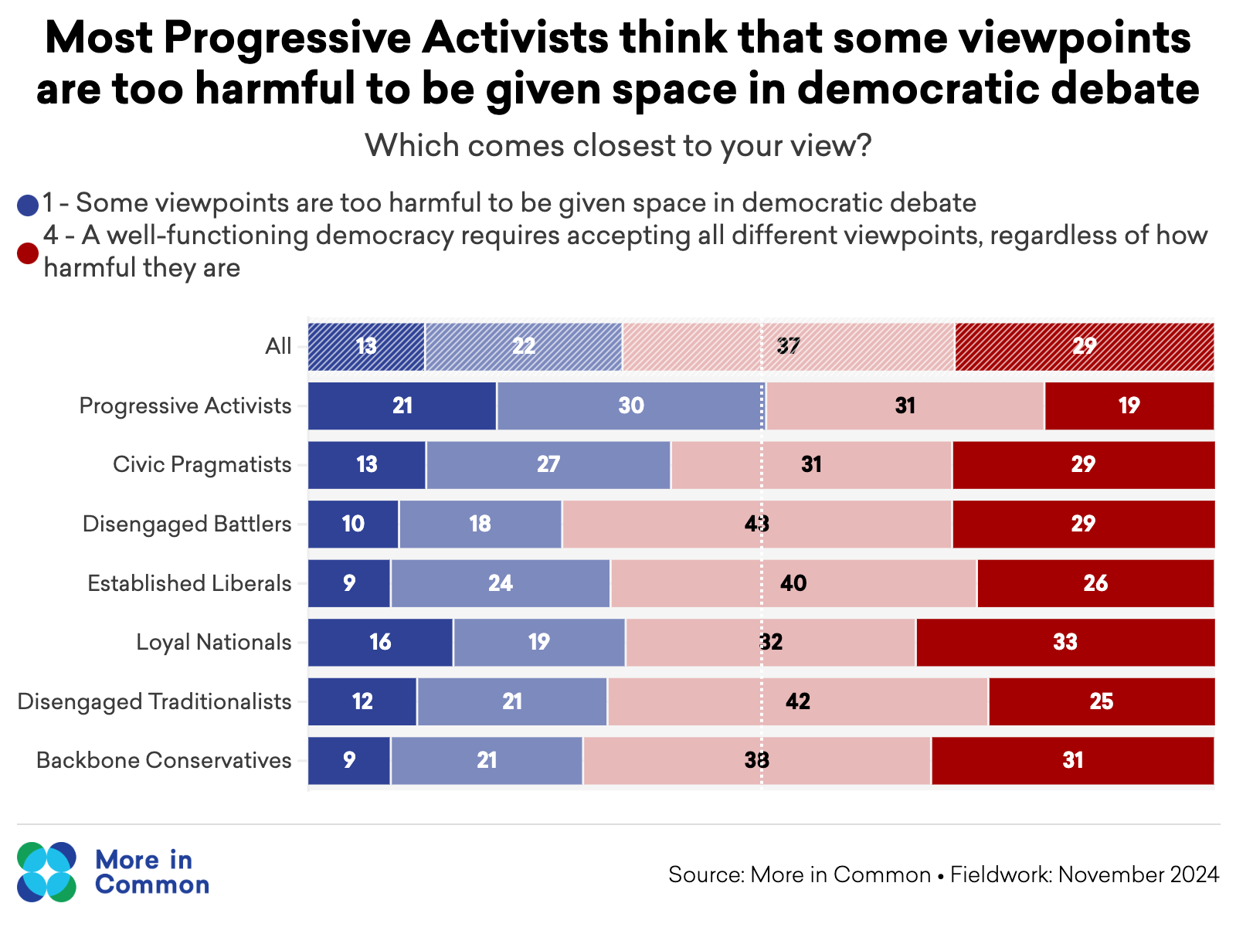
Make space for debate
Progressive Activists are unique amongst the seven segments in their greater likelihood to believe that certain viewpoints are not a legitimate feature of democratic debate. They are the only segment in which a majority (51 per cent) believe some viewpoints are too harmful to be given space in democratic debate, compared to just 33 per cent across other groups.

Slide 20
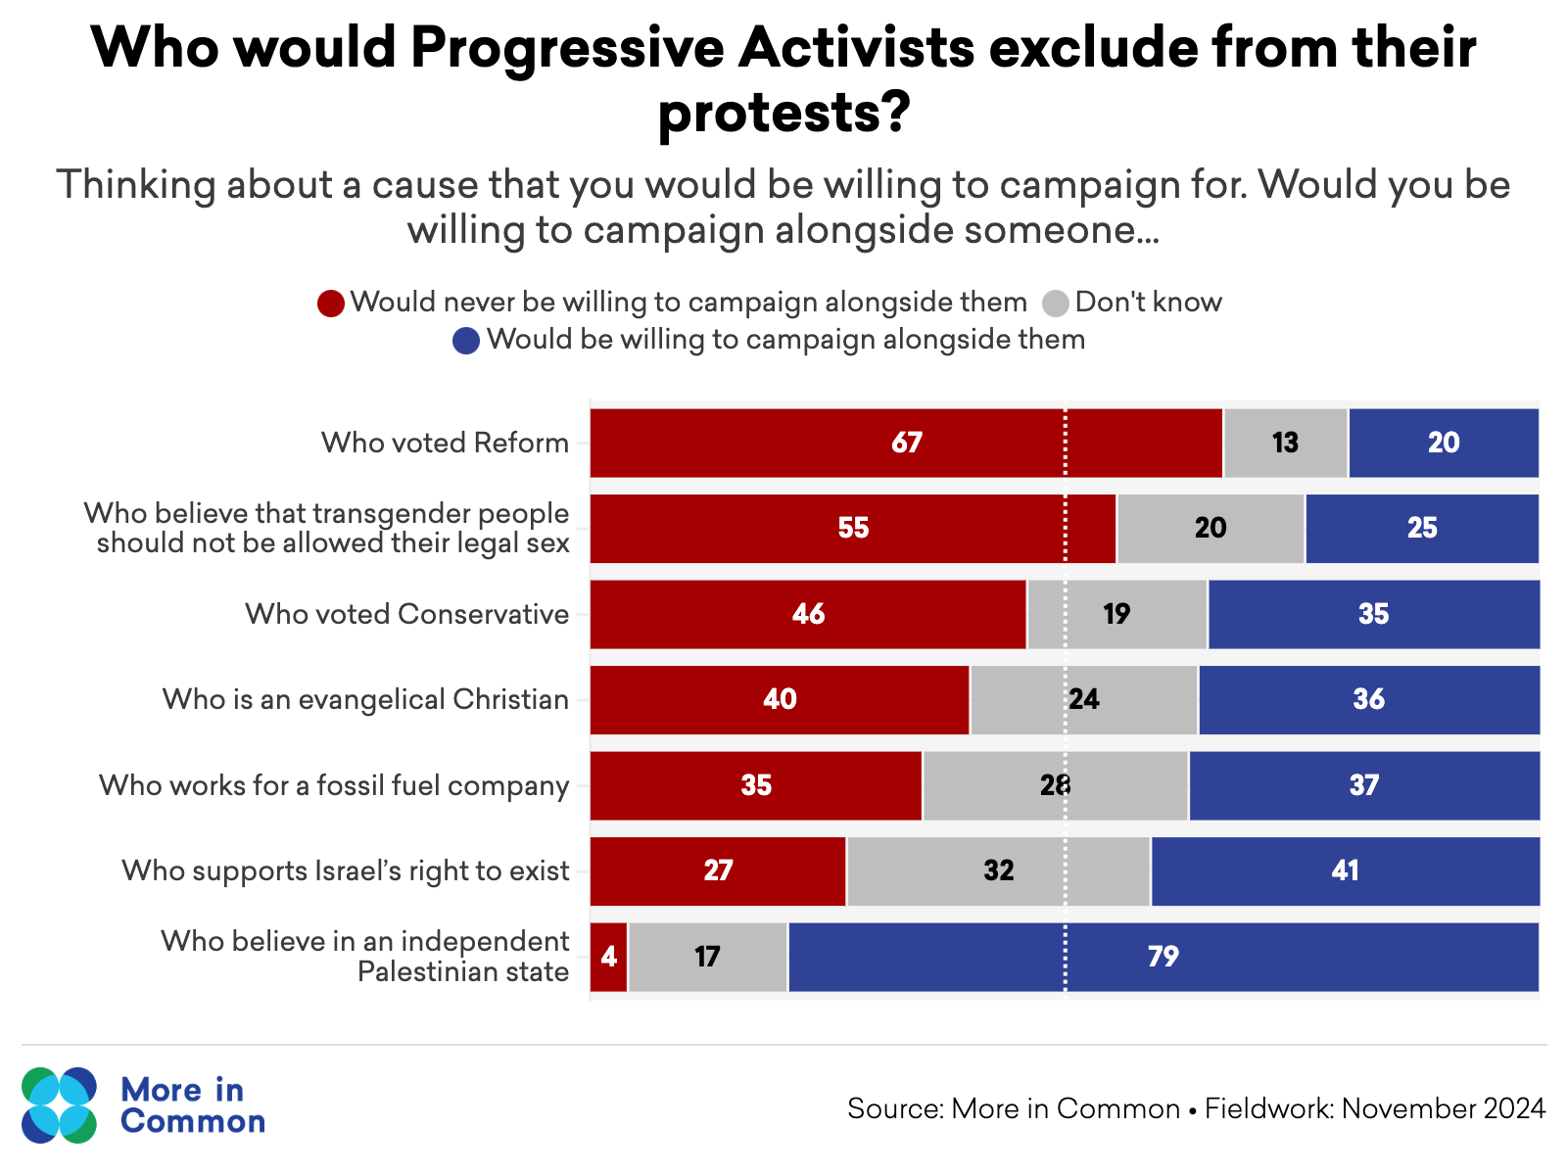
Build broad coalitions
Progressive Activists have a tendency to require comprehensive ideological alignment in their campaigns. In fact, public opinion rarely aligns perfectly along fixed ideological lines. For example, many support climate action while opposing immigration, or favour decriminalisation of drugs while supporting capital punishment. Yet nearly half of Progressive Activists would be unwilling to campaign for a cause they believe in alongside a Conservative. By demanding complete ideological alignment, progressive movements artificially limit their potential support base.

Slide 21
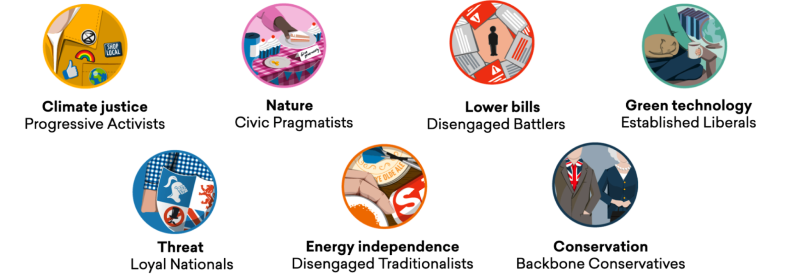
Build broad coalitions
One example of where progressive causes have build broad coalitions is in the environmental movement - where multiple starting points on environmental issues has allowed a variety of people from different backgrounds and worldviews to feel welcome in some campaigns for climate action.

Slide 22
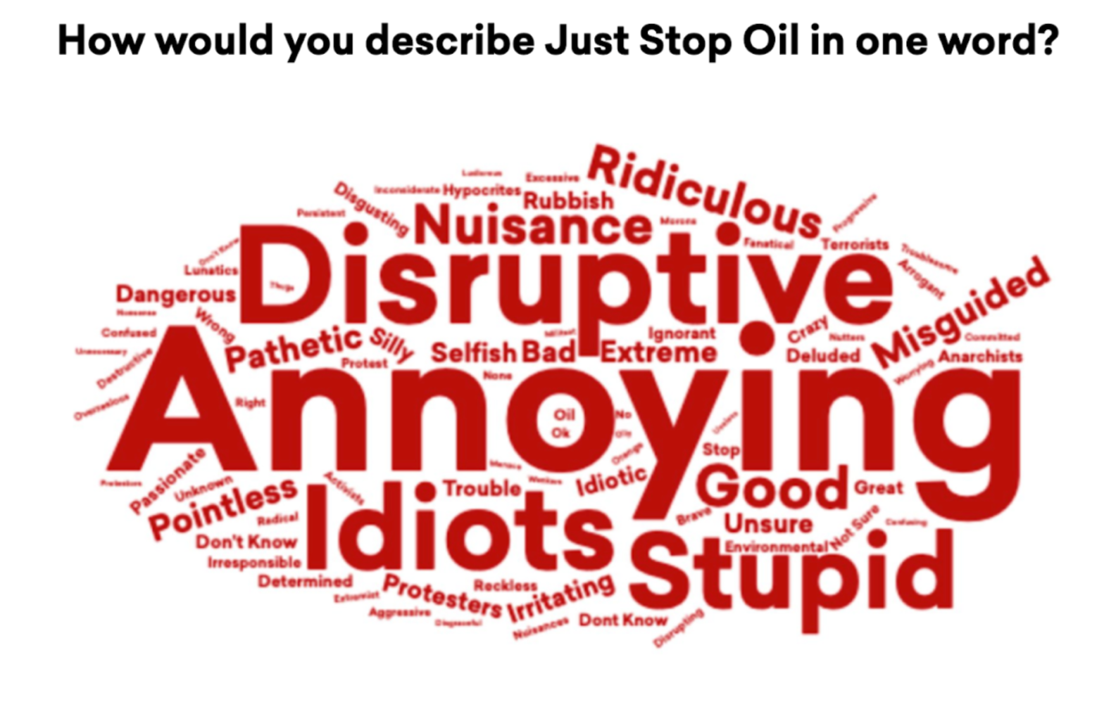
Not all publicity is good publicity
Progressive Activists are much more supportive of disruptive forms of protest. For example, they are the only segment to see Just Stop Oil as a force for good. Sixty five per cent of the public believe that blocking roads is never an acceptable form of protest, compared to just 25 per cent of Progressive Activists.
The issue is that the public are often put off by the more disruptive campaigning of groups such as Just Stop Oil, which can turn people away from causes they might otherwise support.

Slide 23
Not all publicity is good publicity
Progressive Activists are much more supportive of disruptive forms of protest. For example, they are the only segment to see Just Stop Oil as a force for good. Sixty five per cent of the public believe that blocking roads is never an acceptable form of protest, compared to just 25 per cent of Progressive Activists.
The issue is that the public are often put off by the more disruptive campaigning of groups such as Just Stop Oil, which can turn people away from causes they might otherwise support.

Slide 24
Managing progressive workforces

Slide 25
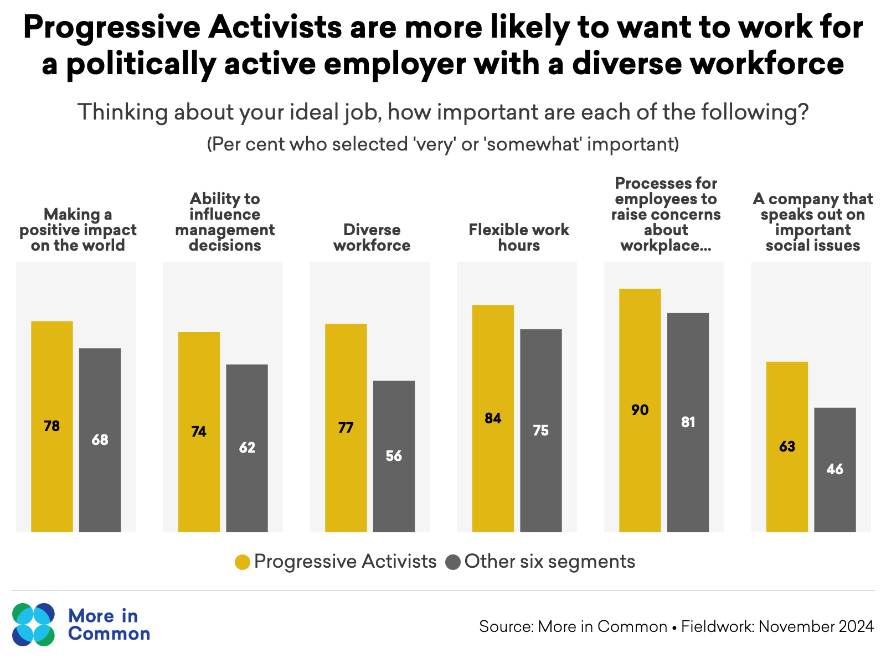
Progressive Activists have unique expectations of their workplace
They are much more likely than average to prioritise having a job which makes a positive impact on the world, where there is ability to influence management decisions and where the employer speaks out publicly on important social issues.

Slide 26
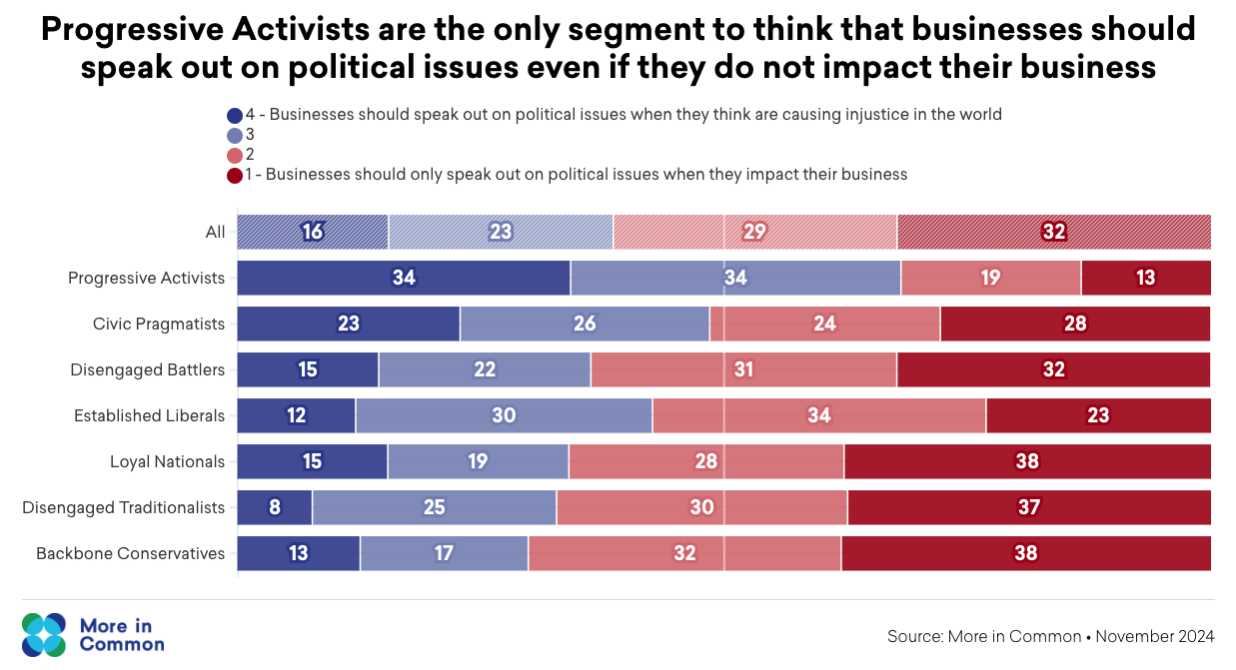
Speaking out on business
Progressive Activists' desire for businesses to speak out on political issues can hinder the progress of civil society organisations. Progressive Activists are the only segment to think that businesses should speak out on political issues not related to their core activity or function. Conversations with charity leaders highlight a growing number of fraught internal discussions about the boundaries of a charity’s mission. In some cases these discussions about what it is and is not appropriate for a charity to publicly comment on has led to internal conflict and distracted charities from delivery of their stated mission.

Slide 27
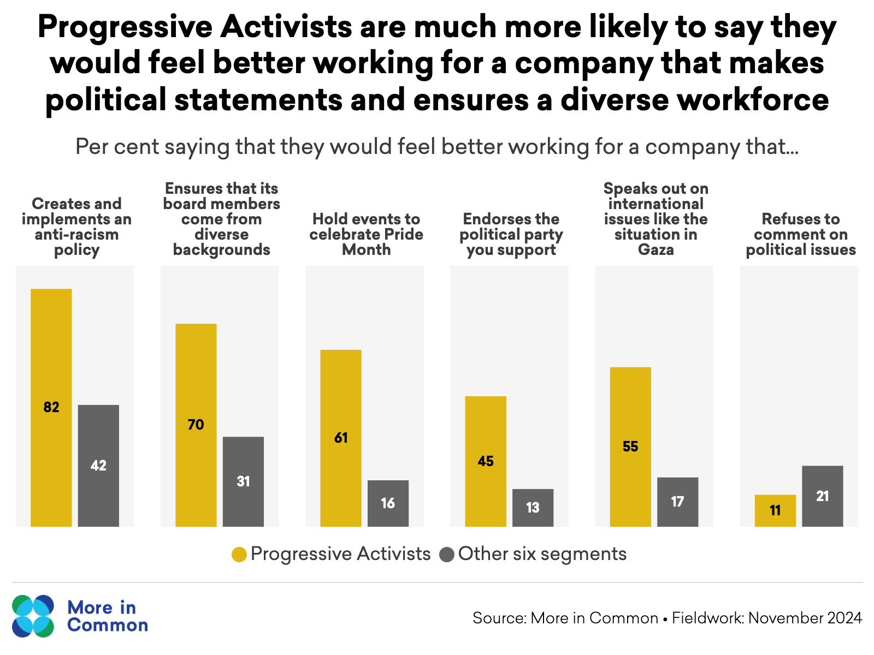
Progressive Activists are much more likely to want an employer that takes political and social action
More than half of Progressive Activists (55 per cent) say they would feel better working for a company that speaks out on international issues, such as the situation in Gaza, compared to just 17 per cent across the other six segments. Similarly, 45 per cent of Progressive Activists would feel better working for a company that endorses their preferred political party, but this would make only 13 per cent of the rest of the country feel better about their employer.

Slide 28
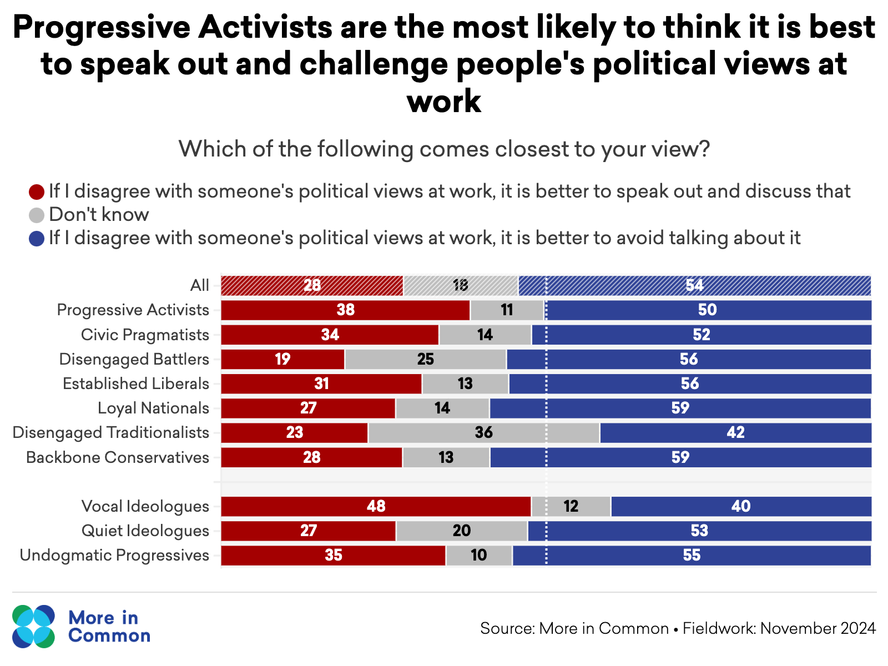
Progressive Activists are the most likely to express their politics at work

Slide 29
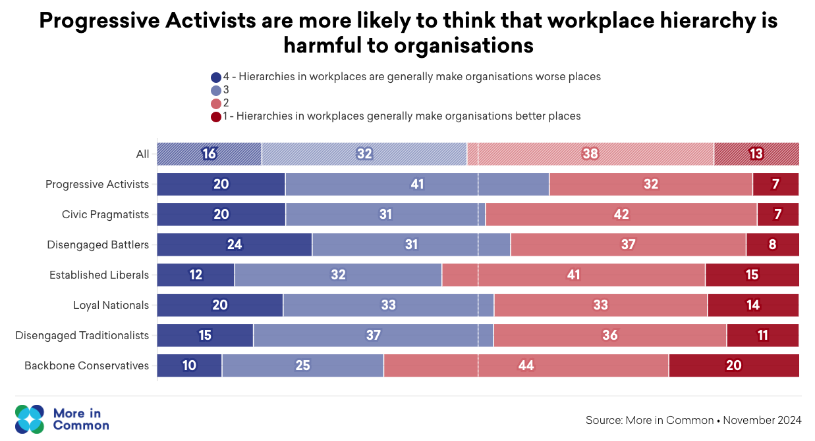
Workplace hierarchy
Compared to the other six segments, Progressive Activists are 12 percentage points more likely to say that an ability to influence management decisions is an important consideration when looking for a job, and nine points more likely to say it is important to them that there are processes to raise complaints internally. However, these beliefs go further: Progressive Activists are notably more likely than other segments to believe that hierarchies tend to make workplaces worse places.

Slide 30
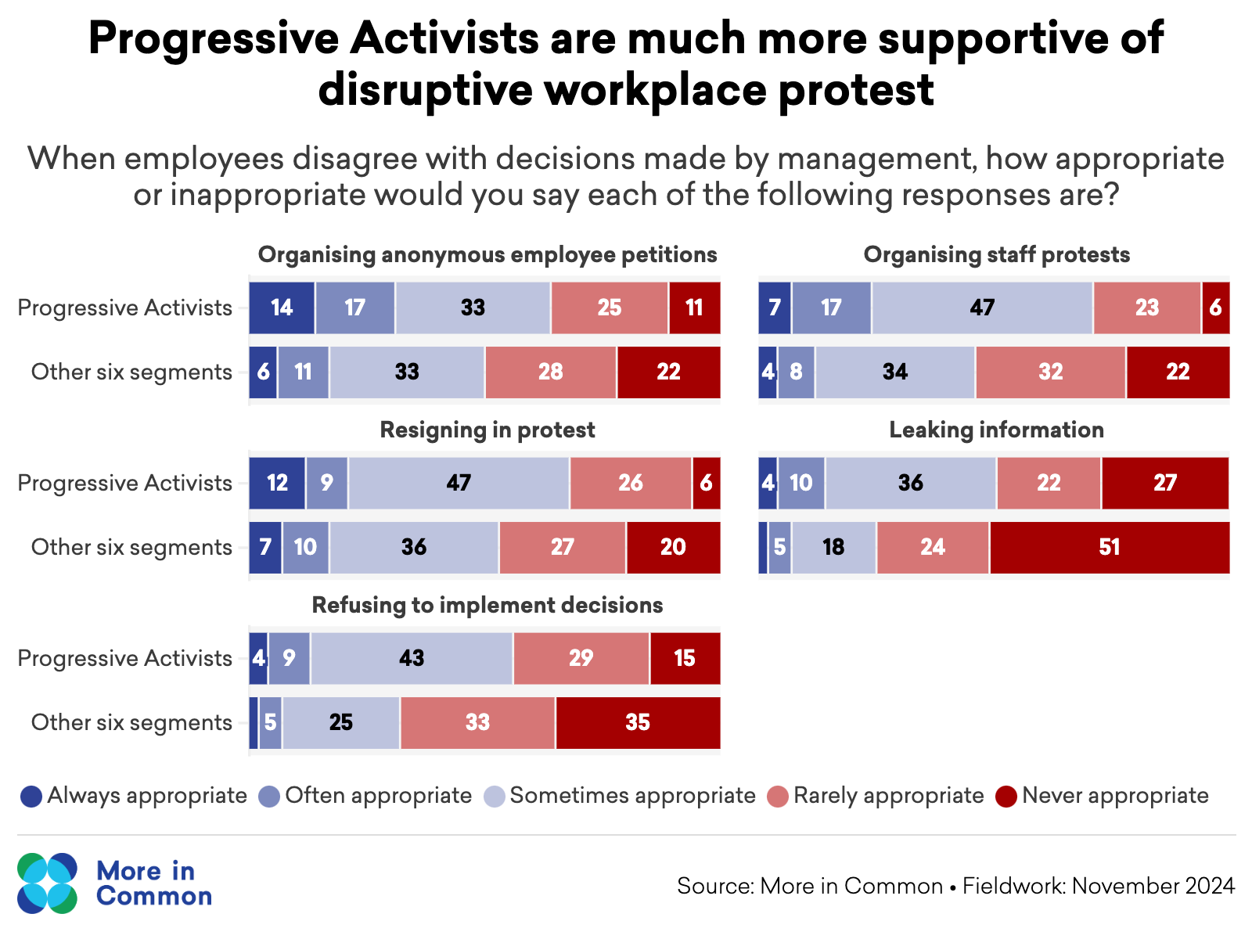
Support for internal activism in workplaces
Progressive Activists are almost twice as likely as other segments to say that it is often or always appropriate to organise employee protests or anonymous petitions, or refuse to implement decisions when staff disagree with management. They are also uniquely likely to raise their political views in the workplace. Thirty eight per cent of Progressive Activists say that it is better to speak out against colleagues' political views at work, compared to much lower rates among other segments. Greater levels of remote working seem to have exacerbated some of these dynamics, with activist staff more likely to behave more aggressively in online staff forums or message boards than they would in person.

Slide 31
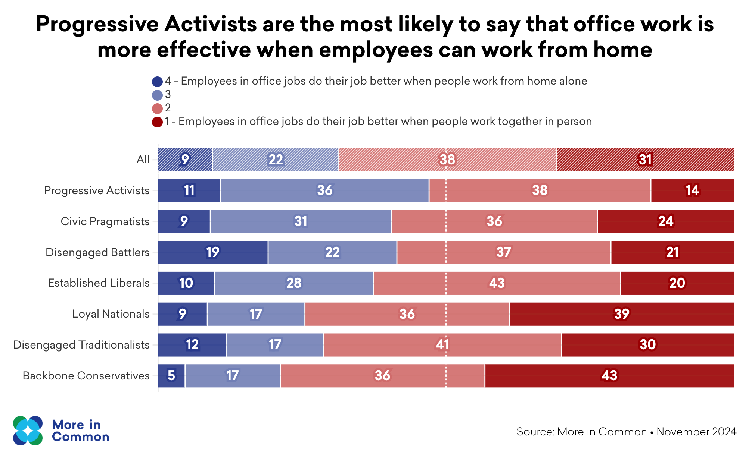
Remote work
From conversations with charity leaders, it is clear that remote work, coupled with Progressive Activists’ more confrontational approach to leadership decisions, can be a damaging mix for organisational culture. This challenge is most often expressed through staff members sending strongly-worded written communications to their colleagues when they have a disagreement, rather than talking through their concerns in person. Clearly online disinhibition effects can lead to people expressing their views in an email more vociferously than how they would express themselves in person. Moreover, remote working can also make it harder for employees to build the relationships that allow potential conflicts to be diffused, or to see the in-person social cues that communicate how someone is responding to a conversation.
“It is a discussion we've had in the organisation about how do we resolve conflict? How do we have difference of opinion? How do we give each other feedback? So what we tend to find is that the mechanism for feedback in our organisation is often through chat functions at all-staff briefings or emails, with quite a hostile questioning of leadership and a cynicism about the intentions of leadership”

Slide 32
Building effective progressive workforces
Make space for constructive conversations and feedback: Create regular, in-person forums for staff to raise concerns. Be clear that, once discussions have occurred, decisions by senior management are final, therefore minimising the need for informal channels for communicating concerns.
Instill a culture of boundaries: Where staff think that it is important to speak out on political issues beyond an organisation’s core mission, it can be helpful to be able to rely on agreed guidelines for when this is and is not appropriate, minimising the need for a new discussion every time a topic of political or social controversy emerges.
Build robust boards: Trustees and non-executive directors should ultimately approve guidelines on what organisations will and will not speak out on. When those policies have been approved, senior management should know that they have the backing of the board to enforce them.
Use inductions effectively: Information on organisational focus and boundaries can form part of employee inductions, setting clear expectations at recruitment stage of what is and is not acceptable within the workplace.
Recruit a diverse workforce: Organisations should review their hiring practices to ensure that they are not inadvertently screening out candidates who share the organisation's core mission but have different perspectives and worldviews. Interview panels should include diverse viewpoints, including charity beneficiaries where appropriate. Creating an environment where reasonable disagreement is acceptable and dominant viewpoints do not become so entrenched that alternative perspectives are dismissed without consideration.

Slide 33
Thank you!
The full report can be found here: www.moreincommon.org.uk

